Slide 1
Adapter Design Pattern
Name: Stefan Humpelstetter
Date:15.11.2017

Slide 2
Content
Issue
Usage
Example
Exercise
Sources

Slide 3
Issue
reuse an already existing component which has a different „view of world“
translate an interface into another one

Slide 4
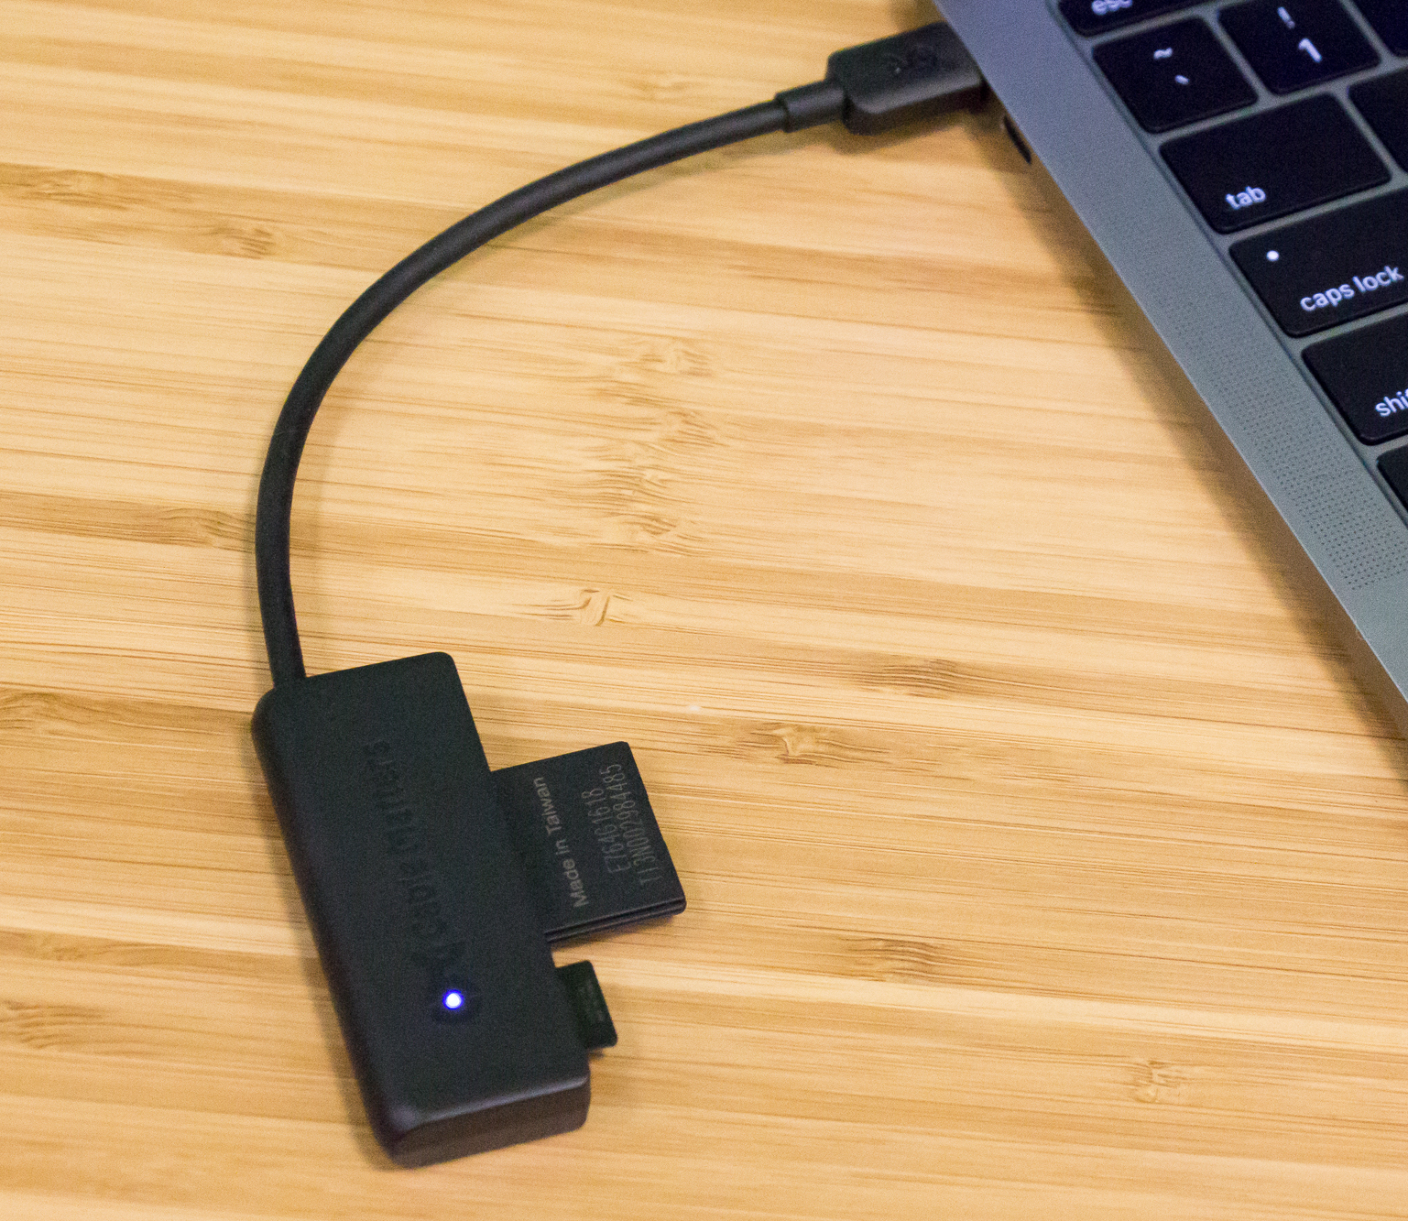
Usage
Like a bridge between two incompatible interfaces
The card reader translates as an adapter the card for the laptop

Slide 5
Example

Slide 6
an Audio Player which can play mp3 files only wants to use an advanced audio player which can play vlc and mp4 files

Slide 7
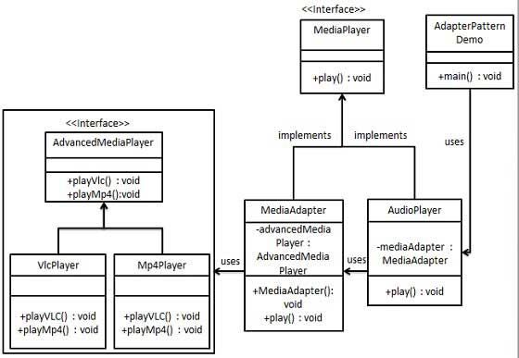

Slide 8



Slide 9
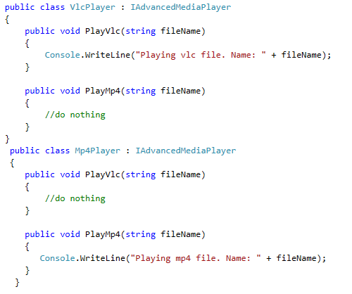

Slide 10
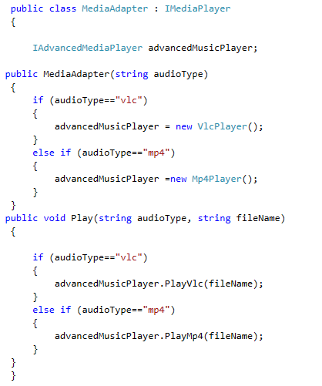

Slide 11
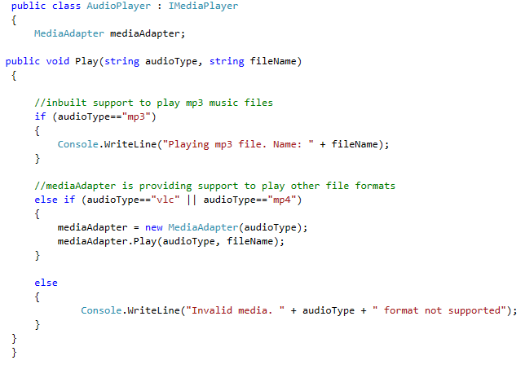

Slide 12
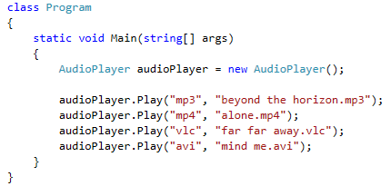
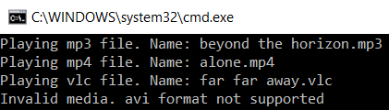
Test

Slide 13
Excercise

Slide 14
Create an even more advanced media player which can play mp5 and vlx format files
Use a new Adapter called AdvancedMediaAdapter
Let the already existing audio player play mp5 and vlx format files

Slide 15
Sources
https://sourcemaking.com/design_patterns/adapter
https://www.tutorialspoint.com/design_pattern/adapter_pattern.htm
https://de.wikipedia.org/wiki/Adapter_(Entwurfsmuster)

